Slide 1
Online Search Terminology and
Key Performance Indicators

Slide 2
Session Overview
Online Search Adverting General Terminologies
Online Search Advertising Business Process Flow
Key Performance Indicators (KPI)
Ad Position
KPI Tree
KPI Chart
Other Important Metrics
Example Scenario – KPIs during Thanksgiving Week
Extra Questions

Slide 3

Online Search Advertising General Terminology
Search page
Web page having a search box (aka Search Toolbar) to facilitate end-users querying related web content
Once search is triggered, a second web page is rendered with search results and relevant advertisements on Mainline or Sidebar
Search Toolbar
A space given on a search engine web page (e.g. MSN Live Search) to enter search queries
Search String
A single or combination of keywords or terms end-users enter in the search toolbar seeking relative web content
Search Bar
Search String

Slide 4
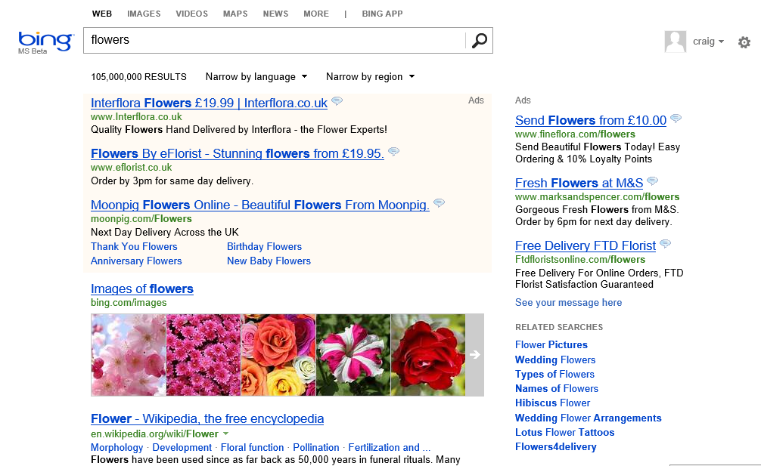
Online Search Advertising General Terminology
Keyword
A single or combination of words which advertisers bid on for which they want their ads to be displayed
Three words usually serve as a practical limit for advertisers
Search Bar
Search result page with Ads
Keyword : Flowers
Text ad/Sponsored Links
Ads with only text and no graphics, having a link to advertisers websites (light and easy to render)

Slide 5

Online Search Advertising General Terminology
Landing page
An active web page where search end-users will be redirected to when they click an online ad
Return on Investment (ROI) usually improves if the landing page directly presents a conversion opportunity (such as purchase, subscribe, etc)
Query (aka Search String)
Search strings entered by end-users in the Search toolbar
Ad Rank
Each ad is assigned a rank using machine learning algorithms based on its past performance and the amount advertiser is willing to spend to display it (bid). The higher the rank, the higher the probability of it being served or rendered
Search Bar

Slide 6
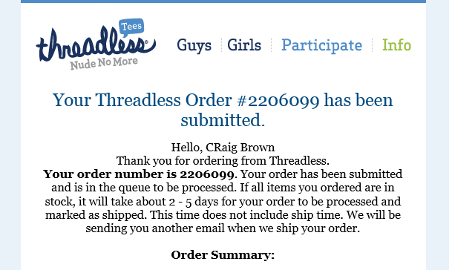
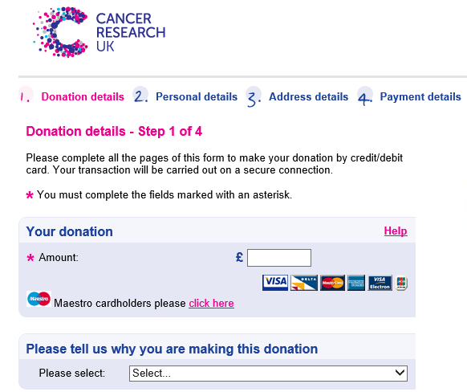

Online Search Advertising General Terminology
Bid
Amount that an advertiser is willing to pay per keyword ( per click ) in the advertising marketplace auction
Bids aren’t always the amount charged to advertisers for clicks. It is the amount they’re is willing to pay The actual amount paid for a click might be lesser than the bid amount ( this is called Second Price Auction)
Second Price Auction: The auction is a sealed-bid auction because advertisers do not know what other advertisers are bidding. The highest bidder wins the auction and gets their advertisement placed on specific pages for specific users, but pays the price of the second highest bidder
Conversion
An activity performed by an end-user when they interact with an ad (for example, clicks a text ad or views a video ad) and then takes an action which fulfils goals set by advertiser
For example, online purchase, signing up for a service, call to the business
Purchase
Donation
Newsletter

Slide 7
Search Ad Business Process Flow
End-User
Clicks on relevant ads
Landing Page
String entered on search bar/other entry points
Search Results + Ads
<< Conversions>>
Publisher
Revenue from Platform to Publisher upon click
Revenue/Other Business goals achieved for Advertisers through End-User upon conversion
Search Query
Ads
Ads Selected
Revenue from Advertisers to Platform upon click
Platform
<< Factors determining ads to be shown >>
<< Auction Marketplace (bidding process) >>
Advertisers
Eg. Quality of Ad, Bid made by Advertiser, Thresholds
Keywords
Bid1 Bid 2 Bid3
Adv 1 Adv 2 Adv 3

Slide 8
Online Search Advertising Basic Key Performance Indicators (KPIs)
Search Result Page View (SRPV)
Search Result Page View independent of Ad Impression or ads being rendered on the landing page
Bidded Search Result Page View (BSRPV)
Search Result Page View having at least 1 Ad Impression on the landing page
Revenue per Search (RPS)
Revenue generated per search
RPS = Total Revenue / Total SRPV’s
Revenue Per Milli (RPM) = RPS x 1000
Price per Click or Cost per Click (PPC or CPC)
Revenue generated per ad click
PPC = Total Revenue / Total Clicks
Impressions
Total number of times an ad is served or rendered on a search page
Notes:
For each KPI, Ask the class if anyone knows what they are first before explaining in detail
Talking Points
Let’s talk about some of the main search terminology and KPIs you will hear. First of all we will start with the physical search related KPIs:
Search Query – Occurs when a user enters a keyword into the search box to perform a search. The page of results that come up as a result of a search query is called a Search Engine Results Page (SERP)
Impression – An impression is where a sponsored search ad is shown to a searcher. Each sponsored search ad shown to a user counts as one impression for the advertiser. The term ‘impression’ is common across all advertising but in search it refers to a search ad being displayed.
How many individual impressions are there on this page? The answer is 6 as there are 6 search ads displayed
Click - When a user clicks on an advertiser’s ad and goes through to the advertiser’s website, this is recorded as a click
Click through rate – is a very important measure of the relevancy of an ad to all searchers and details how often an ad is clicked per its number of impressions. It is calculated by the % of clicks that come from the impressions of an ad. CTR = Total Clicks / Total Impressions
If I had a keyword that delivered 100 ad impressions and was clicked on 9 times, what is my CTR? – Answer is 9%
A good CTR can vary massively depending on the keyword and the product
Brand keyword CTR is often very high (maybe as high as 40-50%), while for generic keywords such as ‘car’, a CTR of 5% may be considered strong

Slide 9
Online Search Advertising Basic Key Performance Indicators (KPIs)
Click through Rate (CTR)
The rate at which an ad is clicked with respect to the total number of ad impressions
CTR = Total Clicks / Total Impressions
Click Yield (CY)
Rate at which an ad is clicked with respect to the total number of Searches
Click Yield = Total Clicks / Total SRPV’s
Impression Yield (IY)
The rate at which an ad is rendered with respect to the total number of search pages
IY = Total Impressions / Total SRPV’s
Coverage
The rate at which at least 1 ad is rendered on a page with respect to the total number of searches
Coverage = Bidded SRPV’s / Total SRPV’s
Ad Density
Ad Density = Total Impressions / Total BSRPV’s
Notes:
For each KPI, Ask the class if anyone knows what they are first before explaining in detail
Talking Points
Let’s talk about some of the main search terminology and KPIs you will hear. First of all we will start with the physical search related KPIs:
Search Query – Occurs when a user enters a keyword into the search box to perform a search. The page of results that come up as a result of a search query is called a Search Engine Results Page (SERP)
Impression – An impression is where a sponsored search ad is shown to a searcher. Each sponsored search ad shown to a user counts as one impression for the advertiser. The term ‘impression’ is common across all advertising but in search it refers to a search ad being displayed.
How many individual impressions are there on this page? The answer is 6 as there are 6 search ads displayed
Click - When a user clicks on an advertiser’s ad and goes through to the advertiser’s website, this is recorded as a click
Click through rate – is a very important measure of the relevancy of an ad to all searchers and details how often an ad is clicked per its number of impressions. It is calculated by the % of clicks that come from the impressions of an ad. CTR = Total Clicks / Total Impressions
If I had a keyword that delivered 100 ad impressions and was clicked on 9 times, what is my CTR? – Answer is 9%
A good CTR can vary massively depending on the keyword and the product
Brand keyword CTR is often very high (maybe as high as 40-50%), while for generic keywords such as ‘car’, a CTR of 5% may be considered strong

Slide 10
Online Search Advertising Basic Key Performance Indicators (KPIs)
Conversion Rate (CVR)
The rate at which conversion occurs with respect to the total number of ad clicks
Conversion Rate = Conversions / Conversion Enabled Clicks
Conversion Enabled Clicks is the total number of clicks coming from campaigns having at least one conversion
Example : 3 Sales / 30 clicks would result in a conversion rate of 10%
Cost Per Acquisition (CPA)
Amount spent by the advertiser per conversion
Cost Per Acquisition = Total Spend / Conversions
Example : Monthly Spend 30.00 / 3 Sales would result in CPA of 10.00

Slide 11
Ad Position
Ad Position is the position of an ad on the Search Result Page View
It is determined by
Bid (The amount that the advertiser is willing to pay per keyword)
Relevance (determined by past performance of the ad, landing page URL and its relevance to user query)
More relevant ads get better positions. Actual Cost per Click is usually less than its max bid set by the advertiser (Second Price Auction)
For example, as shown in the table below, an EBay ad gets better position on the search page as its Click Through Rate (CTR) gets higher ( CTR is a measure for relevance)
Advertiser | Max Bid | Click through rate | Rank | Position
EBay | $5 | 15% | 1 | 1
AT&T | $7 | 10% | 2 | 2
Wirefly | $10 | 5% | 3 | 3
Notes:
Talking Points
Ad Position is Determined by Max Bid and Relevancy. On a very basic level you can think about rank score as being the current CTR multiplied by the maximum bid. In reality, there are many more factors that are involved but this is a good way to look at it when thinking about advertiser performance.
The rank score determines each advertisers position in the listings and because it takes both relevancy and bids into account, it means that relevant advertisers can receive higher placement at more effective costs.
Remember Actual Cost per Click is less than their Max Bid. And so the higher the relevancy, the more cost effective the click is for the advertiser.
If an advertiser has a stronger CTR they can need to pay less in terms of bids to gain a strong position

Slide 12
Online Search Advertising KPI Tree
Revenue
Revenue*1000 / SRPVs
Revenue generated per search helps in gauging the
monetization health of Bing
Search Result Page View
It is independent of Ad Impression
RPM
Revenue per Milli Searches
SRPV
Revenue / Clicks
Average amount paid by an advertiser for a click
Clicks / SRPVs
A higher click yield could mean more relevant
ads are being shown or no. of ads has increased
CPC
CY
Impressions / SRPVs
Can be used to determine if number of ads shown
per page has changed
IY
CTR
Clicks / Impressions
Can be leveraged to assess quality/relevance of ads shown
Revenue per Search (RPS)
RPS = Total Revenue / Total SRPVs
Rate (RPM)
RPM = RPS x 1000
Click Yield (CY)
Coverage
Ad Density
Impressions / BSRPVs
Can be used to understand if platform level thresholds
have been changed or if advertisers are investing more
during the shopping season
BSRPVs / SRPVs
Can be leveraged to measure how many SPRVs
are monetizable
Click Yield = Total Clicks / Total SRPVs
Notes:
Here are some additional KPIs that you might come across. These are KPIs that apply more to reporting to the business on search.
We have provided a hand out with all of these listed

Slide 13
Online Search Advertising KPI Chart
RPS
SRPV
BSRPV
Impression
CPM
Imp Yield
BCTR
CPC
Revenue
Clicks
CPA
Conversion
Coverage
Ad Density
CTR
Conversion Rate
Click Yield

Slide 14

Online Search Advertising Key Performance Indicators – A deep dive
These views allow us to see how fluctuations in such elements such as Searches, RPS, Coverage, Bidded CTR and PPC directly impact Revenue.
In this way, we see that Click Yield is not only a function of the total number of Clicks and Searches, but also directly proportional to Bidded CTR and Coverage. That is, as either Coverage and/or Bidded CTR increase, Click Yield will also increase, and vice versa
Therefore, we see that Bidded CTR is now also directly proportional to both Ad CTR as well as Ad Density. That is, as either Ad CTR or Ad Density increase, so will Bidded CTR, and vice versa.

Slide 15
Online Search Advertising Other Important Metrics
Quick Back Rate (QBR)
The rate at which end users quickly click back with respect to the total number of the same ad being clicked. The amount of time (in seconds) that end-users remain on the landing page after clicking an ad is called Dwell Time
Good clicks are clicks with Dwell time >=20 secs and <1800 secs
Bad clicks are clicks with Dwell time > 0 secs and < 20 secs
QBR = Bad Clicks / (Good Clicks + Bad Clicks)

Slide 16

Online Search Advertising Pixel KPIs
To ensure a healthy relationship between revenue, relevance, and end-user experience, Bing (Publisher) sets a pixel budget for the ad space within Bing Ads Network web interfaces. Once this budget is exhausted, Bing Ads will not be able to display any ads on the publisher’s site. This budget is set in terms of a metric known as PxMLIY.
PxMLIY or Pixel main line impression yield is the average number of Pixels for the mainline ad block (which may include any of these: EXTA, STA, Product Ads, etc.)
Raw PxMLIY:
$SUM (MLLoggedPixelHeight) / SUM (SRPVs)$
PxMLIY Normalized to MLIY Scale: It is normalized by a factor of 74 to put this into the same scale as MLIY
$SUM (MLLoggedPixelHeight) / (SUM (SRPVs) ∗ 74)$
It is normalized by a factor of 74 to put this into the same scale as MLIY
Refer to attached document for more details

Slide 17
Online Search Advertising Sample Values of KPIs
 | PC | Tablet | Mobile HiFi
Volume (M) | 2,945.6 | 260.1 | 657.7
BSRPV (M) | 963.9 | 73.7 | 122.5
Impressions (M) | 3,428.6 | 190.4 | 258.3
Clicks (M) | 219.7 | 21.0 | 29.1
Revenue (M) | $179.3 | $15.2 | $17.3
RPM | $60.87 | $58.29 | $26.31
CPC | $0.82 | $0.72 | $0.59
CY | 7.46% | 8.05% | 4.43%
IY | 1.16 | 0.73 | 0.39
CTR | 6.41% | 11.01% | 11.28%
Coverage | 32.72% | 28.35% | 18.63%
Ad Density | 3.56 | 2.58 | 2.11
Filters: US, Search, Billable, Bing O&O Core, Mar’16

Slide 18
Example Scenario – Online Search Advertising KPIs during Thanksgiving Week
How do the KPIs change during the thanksgiving week ?
Ad Density – Advertisers invest more during the shopping season increasing ads served on queries driving up Ad Density
Coverage – Advertisers might bid on new keywords driving up coverage
IY – Increases from the combined effect of Ad Density and Coverage
CTR – Might increase or decrease from the combined effect of users clicking more on ads thereby increasing CTR and the increase in number of impressions driving down CTR
CY - Increases from the combined effect of IY and CTR
CPC – Increases due to increased advertiser budgets and higher bids due to competition
RPM – Increases from the combined effect of CY and CPC

Slide 19
Online Search Advertising Extra Questions
List down which metrics are relevant to each stakeholder in search industry
How will the KPIs change in the following scenarios:
Start of Month seasonality
End of Month seasonality
Natural disasters
MLR threshold is lowered
Increase in Advertiser competition
Increase in fraud user activity
Introduction of new Ad Extensions/Annotations

